Slide 1

Kafka Knowledge Grooming Brief Overview Jan, 2020

Slide 2
Agenda
Introduction
MQ/JMS - Kafka differences
Kafka Architecture
Kafka installation
TOPIC Creation , command line Kafka message producer and consumer
NBC Kafka Deployment

Slide 3
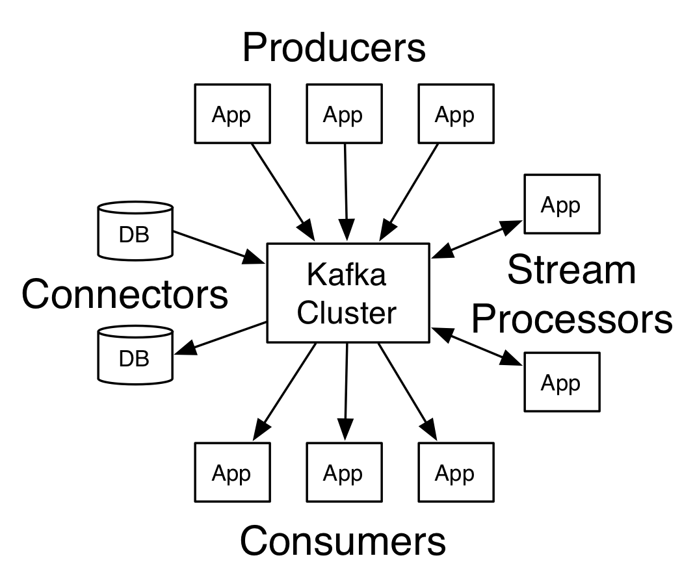
Introduction
Kafka originated at LinkedIn and later became an open-source Apache project in 2011, then a first-class Apache project in 2012.
Kafka is written in Scala and Java. It aims at providing a high-throughput, low-latency platform for handling real-time data feeds.
Key Terminology
Producers of the messages publishes to the Topics
Consumers subscribes to the Topics
Messages are array of bytes. They can be JSON objects, Strings etc
Topics are logs of messages
Kafka is run as a Cluster of servers each of which is called a Broker

Slide 4
MQ/JMS - Kafka differences
No concept of Queue in Kafka i.e., no P2P model
Message Persistence
Topic partitioning
Message sequencing
Message reads
Load balancing
Automatic failover & High availability

Slide 5
Architecture
Producer
Producer
Broker
Broker
ZK
Broker
Broker
Consumer
Consumer

Slide 6
Kafka installation
Downloading site for kafka:
https://www.apache.org/dyn/closer.cgi?path=/kafka/2.4.0/kafka_2.11-2.4.0.tgz

Slide 7
Starting Kafka server
To Start kafka server two steps to be followed
1. Start zookeeper
<kafkaroot>/bin/windows/zookeeper-server-start.bat ../../config/zookeeper.properties
2. Start kafka broker
<kafkaroot>/ bin/windows/kafka-server-start.sh ../../config/server.properties

Slide 8
Creating TOPIC , using kafka producer and consumer
Topic creating using below command:
<<kafkaroot>/bin/windows/kafka-topics.sh --create --bootstrap-server localhost:9092 --replication-factor 1 --partitions 1 --topic test
Start kafka producer to send messages on TOPIC.
<<kafkaroot >>/bin/windows/kafka-console-producer.sh --broker-list localhost:9092 --topic
Start kafka consumer to receive messages from TOPIC
<<kafkaroot >>/bin/windows/kafka-console-consumer.sh --bootstrap-server localhost:9092 --topic test --from-beginning

Slide 9
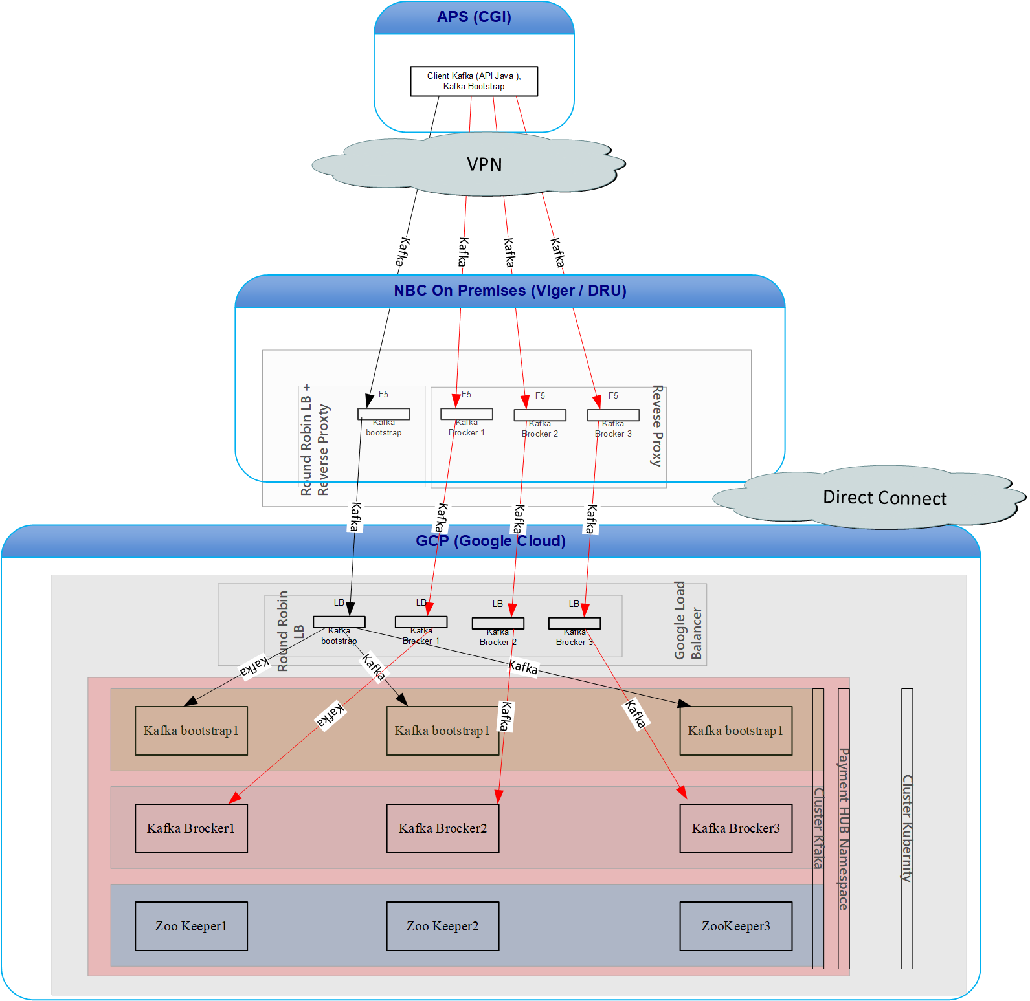
NBC Kafka Deployment

Slide 10
Q & A

